Slide 1

Predictive Analytics-2 Project
Rishi Vyas M (24023401)

Slide 2
Possible Business Scenario
Suppose there is an organization looking to sell mushrooms. They would want to determine whether to sell a particular mushroom or not and keep it in their product portfolio and later measure sourceability, marketability and all other business aspects.
To do this, we need to know whether the mushroom we consider is edible by humans in the first place. The model developed will classify whether a Mushroom is Poisonous/ Edible based on 23 different qualitative features.

Slide 3
Mushroom Classification dataset
This dataset found on Kaggle contains data about different attributes/features of a mushroom with which we can classify them into two categories--- > Poisonous or Edible.
On an average each column of this dataset contains 4 different types of values under each categorical variable.
To make this model more robust and accurate I have used all 8124 rows/ datapoints and 23 columns in the dataset.
Initially it should be noted that the dataset is a very vague and does not contain any clear information about its column variables as shown

Slide 4
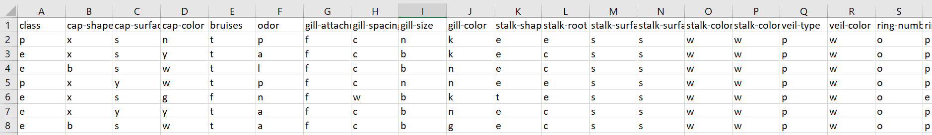
At this stage , the dataset was checked for any abrupt/inaccurate values as well as for missing values as they would be needed to be dealt with in code for good model performance.
Also I understand that we need better and more unique and sensible values in each column so that our model prediction is made easier to code itself.
Here, I observe that this dataset has only categorical variables in all 23 columns and even the target variable I consider: “class” is a categorical variable with two outcomes.
Hence have arrived to a conclusion to use Naïve Bayes Classification to categorize and predict which Mushroom will be Edible and Poisonous based on 23 features.

Slide 5
Naïve Bayes Classification
Naive Bayes is a probabilistic machine learning algorithm based on Bayes' Theorem. It is widely used for classification tasks and is particularly effective for large datasets with multiple features. Despite its simplicity, it often performs well in various domains such as text classification, spam filtering, and sentiment analysis.
It is used on datasets having independent (X’s) and dependent variables (Y) as categorical variables.
Advantages
Easy to implement.
Requires relatively less Training data.
Fast to implement and scalable.

Slide 6
No need of Feature Scaling
Naive Bayes uses probabilities to make predictions, not distances or magnitudes like algorithms such as k-Nearest Neighbors or Support Vector Machines.
It calculates the probability of a class given the feature values using Bayes' Theorem. Each feature's probability is considered independently (conditional independence assumption), so the algorithm doesn't rely on the scale or range of the features.
No need of Multicollinearity handling
Naive Bayes assumes conditional independence between features given the target variable.
Even if features are highly correlated (i.e., multicollinearity exists), the algorithm treats them as independent, so it doesn’t directly consider the correlations.

Slide 7
Flow of Naïve Bayes Classification of Mushroom Dataset
Initially familiarizing with the contents of the dataset and checking for irrelevant/ missing values in the dataset. Identifying the target variable and independent variables based on a general understanding of the topic.
Load all the required libraries
Next, setting the working directory to required path------- > Loading the dataset to R studio using “read.csv”
View the dataset in R and check for any data loss or change in any row or or column names.
Based on the encoding which needs to be done I have rewritten the contents of each column to the required way using R programming---”case_when” function.

Slide 8
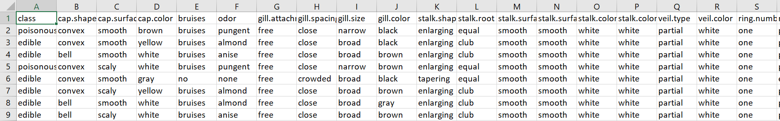
Write the above modified excel file into a new name and store in working directory. Now load this dataset into a new dataframe name : here, “mushroomData”
Check the structure and View the dataframe in R.
Converting the Y amd all X’s into factor datatype (as a dropdown) from the original character datatype.
There is no need of any feature scaling here. As of now all the 23 independent variables look very reliable in determining the nature of the mushroom. Hence we go ahead with Train test split of the 8000+ datapoints into a 70:30 ratio

Slide 9
Now, we need to train the model using “naïveBayes” machine learning algorithm on the Training data alone (5000+ datapoints). This should be very much sufficient in making the model learn.
Also, model training should not be done with entirety of data as it will lead to overfitting and biased/improper results when we take a portion of the same data for testing. As this data has already been exposed and been trained on. It is not very reliable.
Testing data is 2000+ datapoints approx. to check model performance. Use the “predict” function to make predictions on testing data using the trained model.
Check Model Performance using Confusion Matrix and other Metrics like Accuracy, Precision, Sensitivity , Mis classification Rate etc.

Slide 10
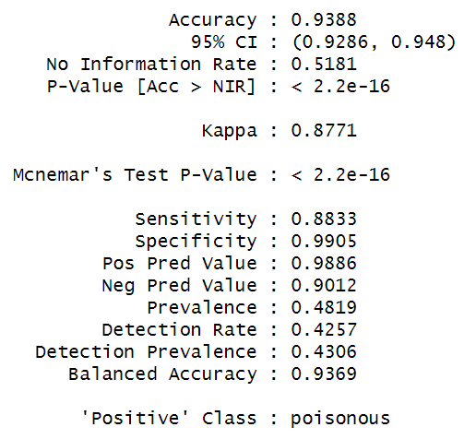
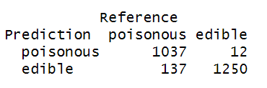
Model Performance Metrics

Slide 11
Sensitivity: How many correct Predictions are made out the total actual positives
TP/(TP+FN) = 1037/(1037+137) = 0.883
Precision(Pos Pred Val): Out of all total positives predicted, how many are correctly predicted.
TP/(TP+FP) = 1037/(1037+ 12) = 0.988
Specificity: Out of total actual negatives values, how many are correctly classified as negatives.
TN/(TN+FP) = 1250/(1250+ 12) = 0.990
Accuracy: The amount of True predictions compared to the entire sample size(testdata)
TTP+TN/ Entire sample tested= 1037+1250/(1250+1037+12+137) = 0.938 ~ 94%

Slide 12
Type 1 and Type 2 Errors
Generally False positives are Type1 errors and False Negatives are Type 2 errors.
In a business scenario, one error may take significance over another. Similarly in my scenario, looking at my Type-1 error---------I have predicted that 12 are poisonous when they are actually edible----------- This could lead to a monetary loss as they would not capitalize these and sell them.
Whereas in my Type -2 error, I am predicting that 137 are edible while they are actually poisonous. This could lead them to be sold and when people consume them, the may fall sick/die---------This could lead to suing, lawsuits and even more reputation and monetary destruction.
Hence we try to reduce Type – 2 error here.

Slide 13
Thank You

